Slide 1
Deep dive in BOT Platform

Slide 2
How to design a bot?

Slide 3




































































There are many different kinds of bots…

Slide 4
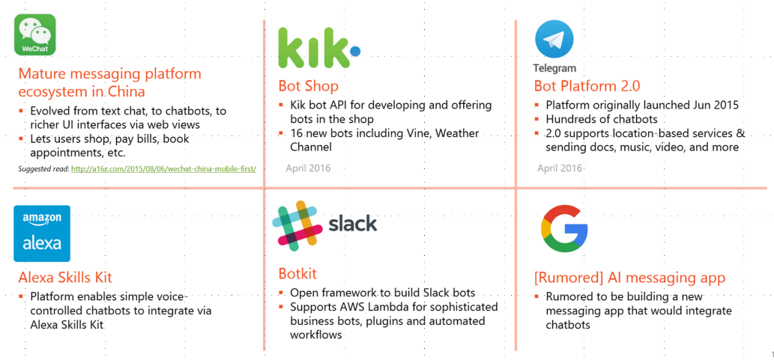
across many different canvases…
The CaaP landscape beyond Microsoft and Facebook
Source: Competitive report and strategic overview series, Kurt DelBene (April 2016)

Slide 5
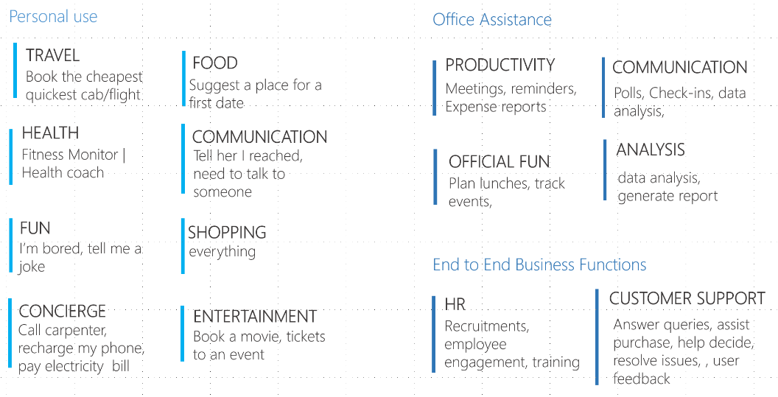
and serving many different kinds of tasks…
Source: Conversational Interfaces, STCI Research (March 2016)

Slide 6
Despite all the differences, common user requirements emerge
We can develop a more engaging and usable experience by designing for:
Real User Needs: meet the needs people have while chatting
Discoverability: awareness of bots and their features
First use: guidance for first run use
Input: appropriate, natural modalities
Output: surfacing information clearly and effectively
Responsiveness: timeliness and relevance of responses
Personality: verbal and visual cues that can enhance user engagement
Context: knowledge of situations and previous exchanges
Privacy: actions that build trust
Ongoing engagement: methods for creating repeated usage

Slide 7
1. Real User Needs
Successful utility bots provide new functionality that fulfills unmet needs. In most cases, simply porting an existing experience to a chat bot will not work because it’s hard to replace users’ existing habits. Build bot experiences that meet the needs people have when chatting.
Focus on solving real-world problems more efficiently than existing solutions.
Drive for convenience because it’s a key driver of bot usage.
To the extent possible, keep people in the chat experience so they don’t lose context.

Slide 8
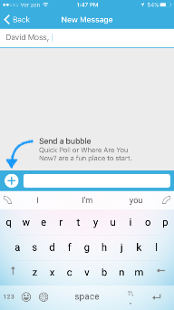

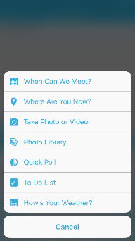
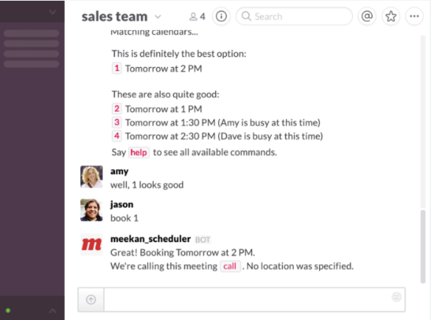
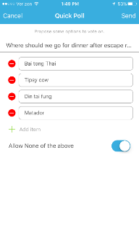
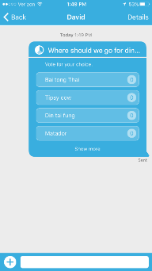
Examples of meeting Real User Needs
Cola bots keep it all in-chat: Users can use Cola bots to send out polls, create to-do lists, locate each other, etc. Everything is kept in the conversation so users don’t have to leave.
Slack bots solve real-world problems: The Meekan_scheduler bot coordinates calendars and finds the best time/place for a meeting.

Slide 9
2. Discoverability
People need to discover how to obtain the bot and, once they have it, discover the bot’s features.
Bot Discovery
Build in ways for users to discover the bot.
Look for exciting, shareable features.
Feature Discovery
An easy OOBE can make a big difference.
Reinforce feature discovery by responding to chit chat and user explorations, as well as surfacing suggestions or promoting new “skills.”

Slide 10

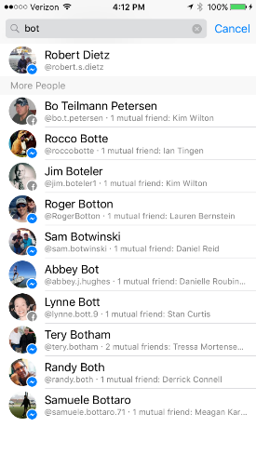
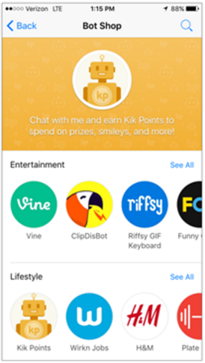
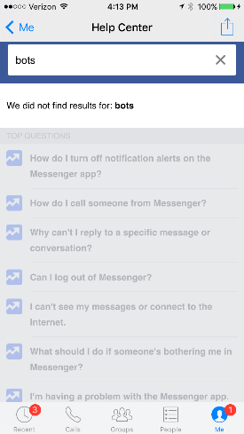
Examples of Discoverability
Facebook Messenger bots are hard to find As a result, most users don’t even know bots exist on this platform.
Kik’s Bot Shop makes bots easy to find Kik offers an easily accessible Bot Shop in which users can browse and discover bots.

Slide 11
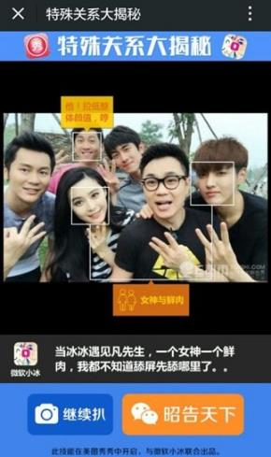
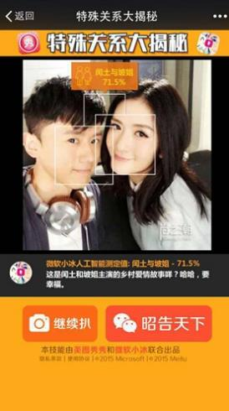
Examples of Discoverability
Xiaoice is engaging and viral
Xiaoice uses image technology for engaging party tricks like telling users which two people in a picture are most likely to date, who in a picture is most attractive, or who in a picture should pay for dinner. Users share these fun features with friends, helping new users discover Xiaoice.

Slide 12
3. First Use Experience
The first use experience is a great opportunity to teach the user about the bot’s capabilities and how to interact with the bot, as well as providing an initial impression of the bot’s personality.
Be clear about the value prop so the user knows what the bot can do and what problems it can solve
Instruct the user how to use the bot, so they can immediately begin interacting with it
Make it easy for users to find these instructions again later, as they’re likely to forget, especially if instructions are complicated or they don’t use the bot for a bit
If possible, put legalese and policies on bot’s contact page or somewhere other than in the first use messaging. Legalese interferes with the bot’s personality, and adds a lot of text that most users won’t read

Slide 13
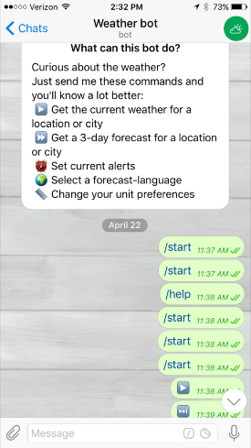
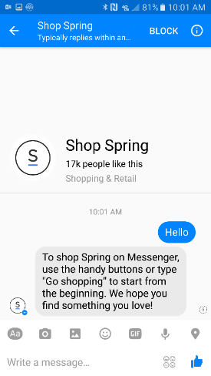
Examples of First Use Experience
Weather bot on Telegram has easy instructions It has a nice first-use message (although none of the commands seem to work)
Shop Spring bot on FB Messenger gives no instructions: Nothing happens until user types something. Then, instructions appear and point users to buttons that don’t exist

Slide 14
4. Input
People don’t want to spend a lot of time figuring out how to interact with a bot. Good support for natural language allows the bot to ‘just work’. Keyboard usage on mobile devices can be annoying, so allowing voice and providing clear action buttons can be very useful.
Maximize natural language. If syntax is required, make it simple and memorable.
Users may be using voice or text input. Users may frame their request differently depending on the input, and there may be extra utterances (e.g. “umm”) in voice input.
People may favor different input methods based on their situation. For example, if they are at work they may be using keyboard. If that’s the case, it might be inappropriate to respond to text input with audio output.
Recognition is easier than recall and can help improve the usability of products. Reduce the amount of keyboard usage and minimize cognitive load by providing contextually relevant action buttons/links.

Slide 15
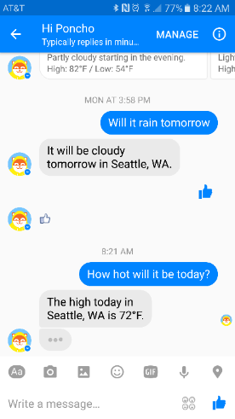
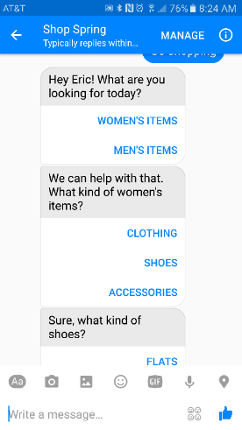
Examples of Input
Hi Poncho uses natural language Hi Poncho on FB responds to natural language queries about the weather and even reacts to ‘Likes’
Shop Spring uses recognition over recall Shop Spring presents its categories as action buttons, enabling users to quickly browse without having to figure out syntax

Slide 16
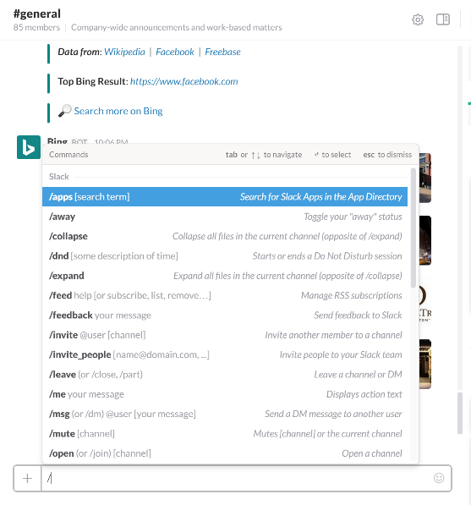
Examples of Input
Slack provides syntax assistance Slack opens an autosuggest menu when the user types "@" or "/" to prompt the user with common commands.

Slide 17
5. Output
The output of a conversation is the payoff for interacting with a bot. We need to celebrate our content.
Text: Avoid walls of text. Use cards, media, and other modalities when appropriate.
Cards: People tend to respond positively to cards that have:
Clean design and good layout
Clear information hierarchy
Information that effectively supports decision making (e.g., length of a movie, # of pages in a book, synopsis of a play)
For content that is time-relevant (e.g., stocks, scores, weather), use a date and time stamp
Carousels: Useful for displaying multiple cards, but are not appropriate for comparing information (e.g., seeing a 5 day weather forecast, seeing stocks in your portfolio, seeing a sports schedule).

Slide 18
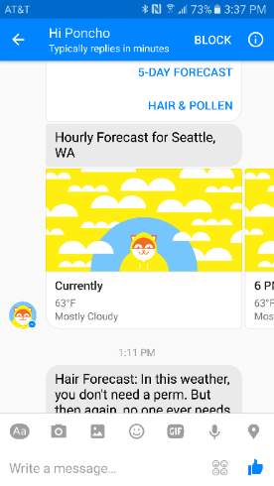

Examples of Output
Carousels prevent easy comparisons A carousel is an inefficient way to display a weather forecast – like in example with Hi Poncho.
Cards for weather often use information hierarchy Temperature is largest text,
icon has a pop of color. Lower priority weather details are present, but lower contrast font.

Slide 19
6. Responsiveness
Responses provide valuable feedback for learning.
Bots should respond to all input. Responses should be relevant, non-repetitive, and timely.
For slow replies, the bot might give an “I’m thinking” cue like “…” to indicate it’s processing.
If the bot can’t find anything relevant, then some response is better than no response, as no response leaves the user unsure whether something is broken.
Bot should be flexible in understanding word order.

Slide 20
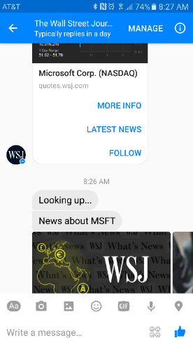
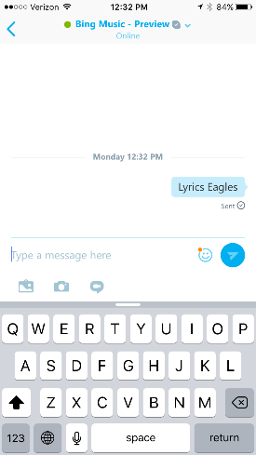
Examples of Responsiveness
The WSJ bot has “I’m Thinking” cue The WSJ bot lets the user know that it is ‘looking up’ something shortly after you make a selection.
No response in the Bing Music App for Skype: The bot returns nothing for Lyrics Eagles, although the message was clearly sent. Frustrating for user to get no response.

Slide 21

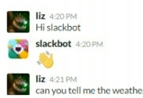
7. Personality
Personality is part of the bot experience, even for a utility bot.
Personality is unavoidable. If you don’t build it in, users will infer their own.
Personality primarily comes from wording, but also media choices, manners & responsiveness, audio characteristics, and avatars.
When completing tasks, bot communication should be efficient yet friendly.
But when fulfilling social functions, bots can showcase a more “fun” personality and engaging skills. Bots should reach out to users, as well as the reverse – narrative can help.
In general, users respond best to young, attractive, female characteristics in bots (voice, etc.).

Slide 22




Examples of Personality
@gif
Telegram
Google Now
Slackbot
Facebook M
Telegram bots (@gif, PollBot) | Google Now | Slackbot | Facebook M
Personality from: Curatorial choices | Personality from: Phrasing (“robotic”) Message duration Voice audio | Personality from: Phrasing (“quirky”) Exclamation points! Emoji | Personality from: Phrasing Fun exchanges & Easter eggs “Human” task completion
Described as: Precise Purposeful Formal Analytical Expressive | Described as: Purposeful Precise Formal | Described as: Sociable Caring Enthusiastic Relaxed | Described as: Precise Purposeful Sociable Enthusiastic

Slide 23
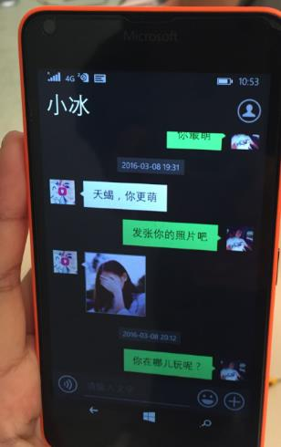
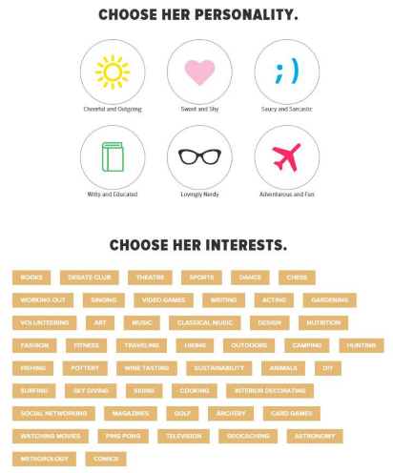
Examples of delivering on Personality
Xiaoice has a fun personality Here, the user asked Xiaoice to send a photo of herself and replies with a hidden face. This was considered as positive and playful.
Choose the personality of the Invisible Girlfriend bot Users choose personality traits during set up. Plus interests and demographics. And it can be changed later on.

Slide 24
8. Context
Contextual awareness increases bots’ believability and usefulness.
Bots can show context awareness of:
User intent (basic relevance)
Location and situation (e.g. traffic, shopping)
Past conversational exchanges (“Are you feeling better today?”)
Social or emotional state of the user

Slide 25
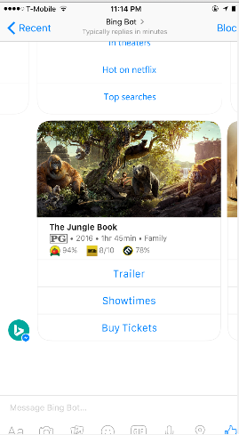
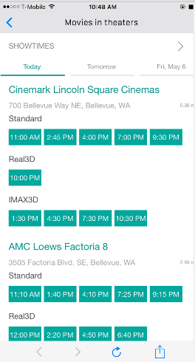
Examples of Context
Bing Bot for FB Messenger uses location data Knowing the user’s location lets the bot provide useful local information.

Slide 26
9. Privacy
Some of users’ biggest concerns in this space are around security and privacy – What is being shared, and with whom?
This includes concerns about the bot developer, the platform, and people in the conversation.
Make it clear to users what is shared, particularly in human-to-human+bot scenarios.

Slide 27
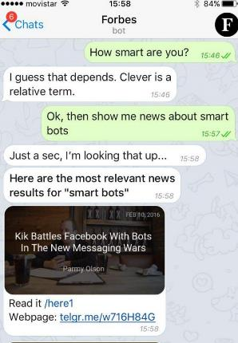
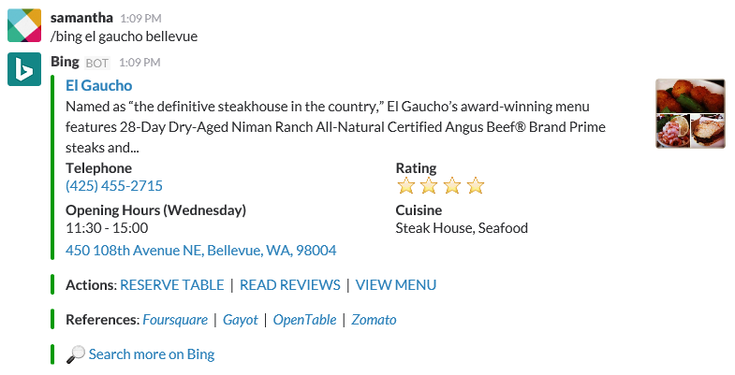
Examples of Privacy
Telegram privacy concerns Users are intrigued by bots, but are concerned that Telegram or the 3rd party developer would be monitoring and saving conversations.
Bing App for Slack privacy concerns Users loved the useful information, but were worried that their searches would auto-post and their chat-mates would see all of their searches.

Slide 28
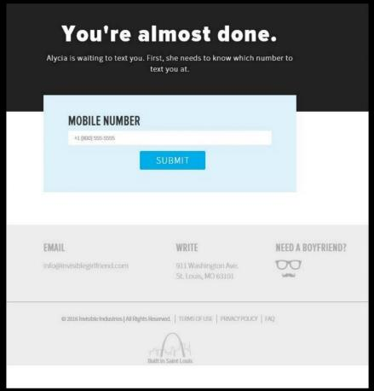
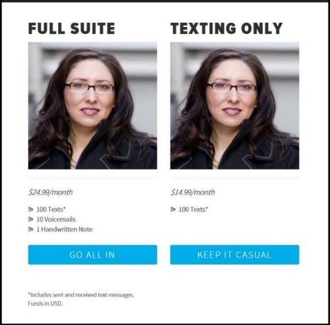
Examples of Privacy
Invisible Girlfriend bot privacy concerns By the end of the sign-up process, user doesn’t trust the system enough to share information. It asks for particularly private info (phone number, credit card), but wasn’t clear where information would go or who would see it.

Slide 29
10. Ongoing Engagement
For most bots, the goal is ongoing engagement – not just a single use. The following things can lead to repeated usage.
Proactivity can be effective for re-engagement, but can quickly turn into clutter
Situational triggers can be powerful. Repeat bot usage primarily comes when a user need arises and the bot is the easiest way to address it.
Example: Booking a restaurant is much simpler with Facebook M
Promote ongoing user education through multiple approaches
Releasing updates on a regular schedule can lead to regular re-engagement

Slide 30
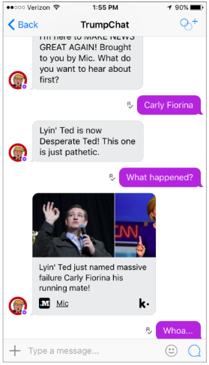
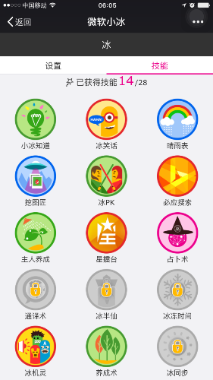
Examples of Ongoing Engagement
TrumpChat uses notifications well This Kik bot is simple, but engaging because it’s entertaining and offers 3 quick election news stories per day. Also pings users once a day reminding them of updated news.
Xiaoice announces new skills every Wednesday
A regular schedule of new features re-engages users by reminding and enticing them. Example skills:
Counting sheep
Chinese word play
Telling jokes
Guessing age
Judging beauty
Toilet time jokes
PK fighting
Weather
Read your mind

Slide 31
Bot Platform

Slide 32
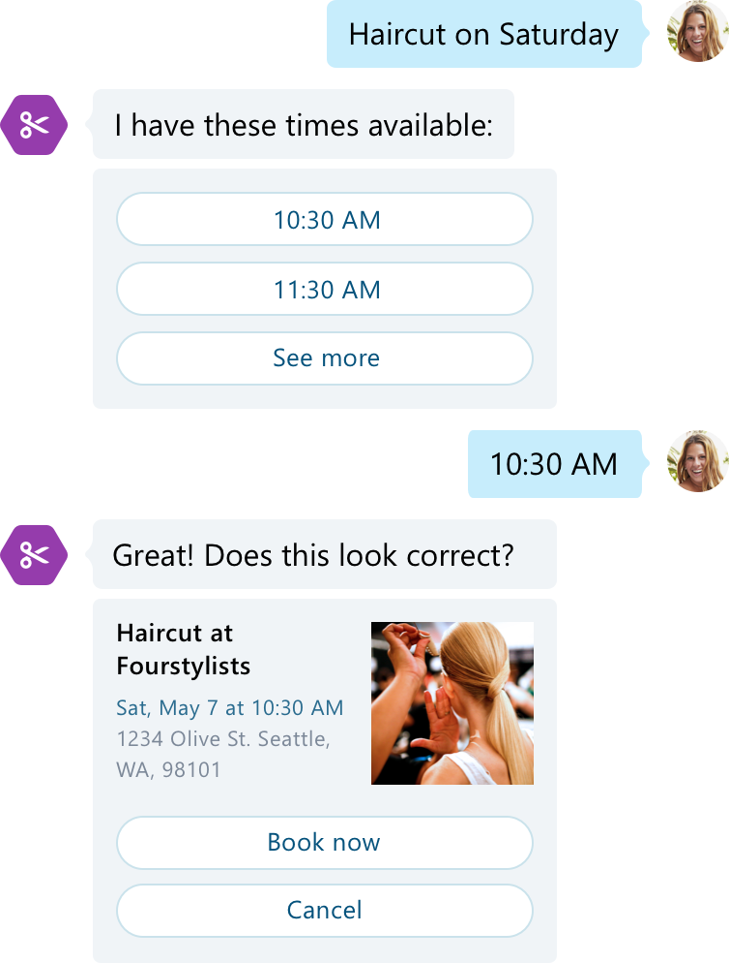
Bots are not artificial intelligence only

Slide 33
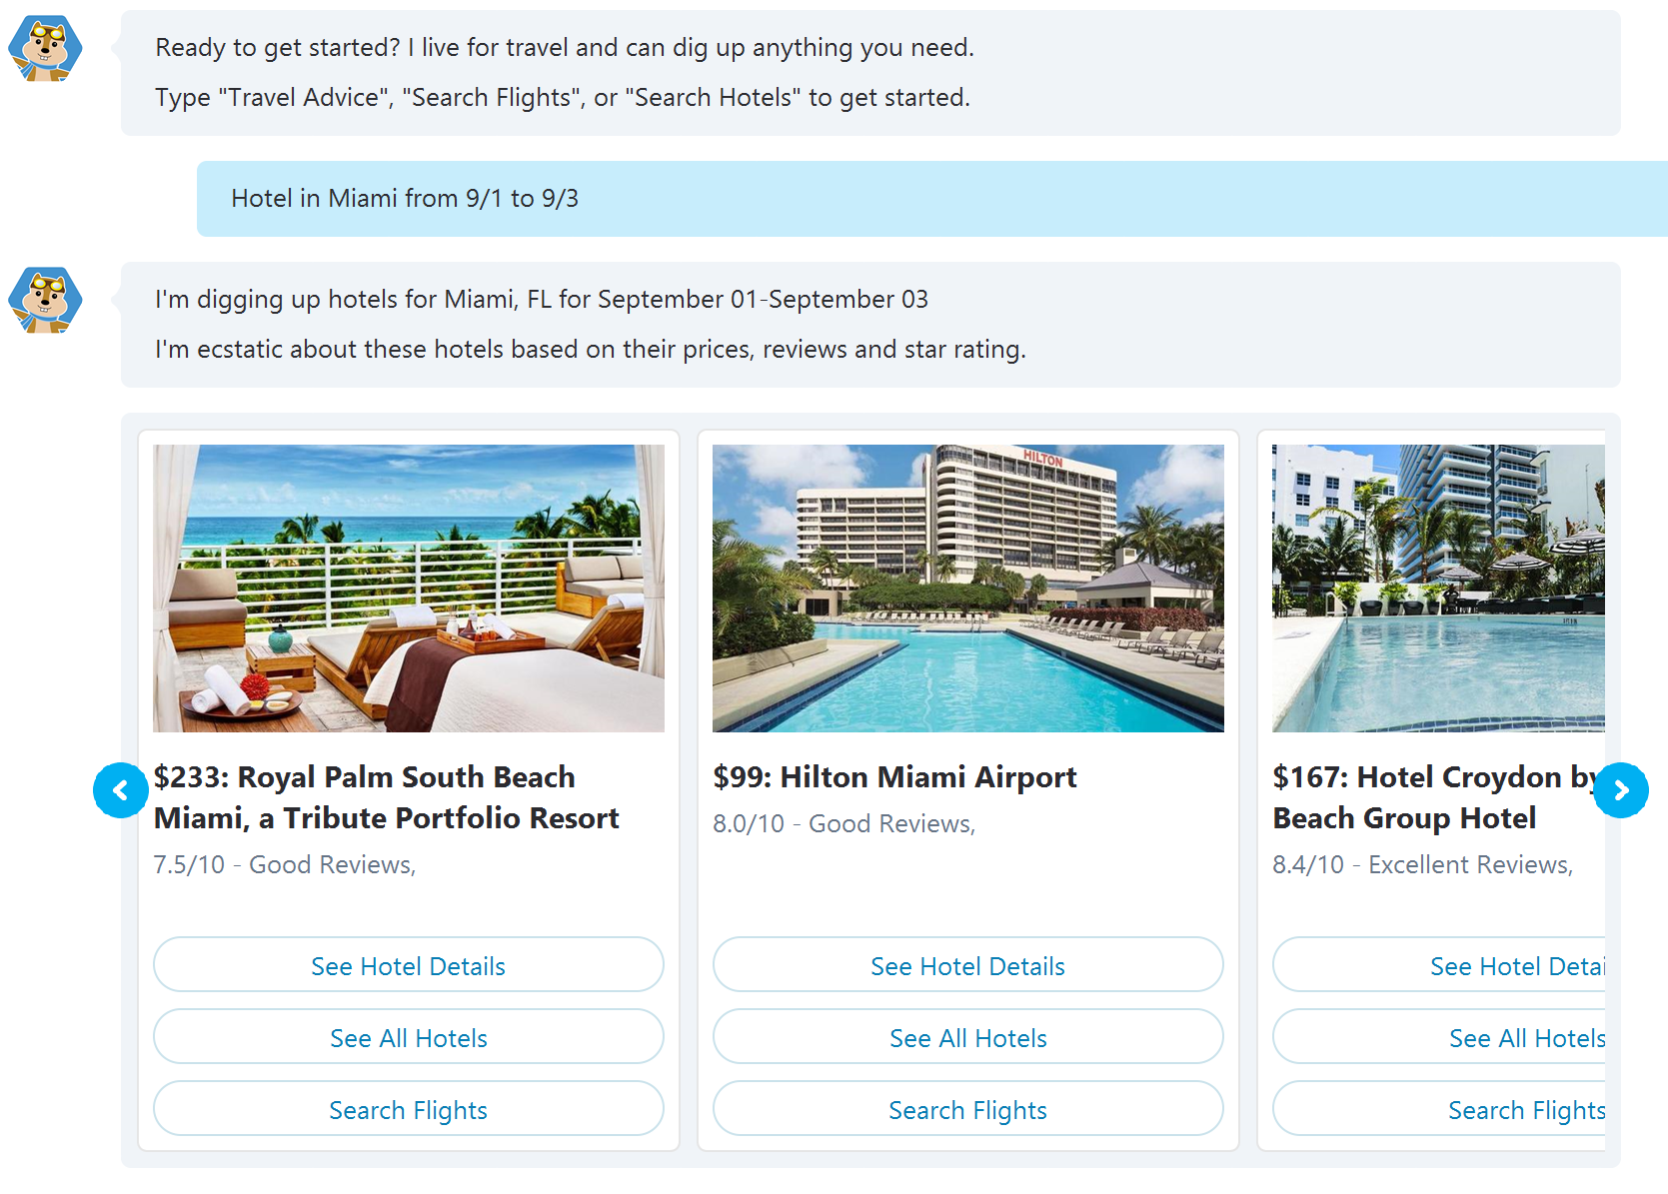
Bots are not text interface only

Slide 34







What are Bots?
Bots are apps with a new interface that provide more natural interactions
Your Data
Connector
State
Other
Services

Slide 35
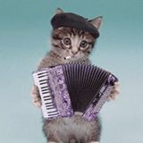


Bot Connector
Conversation Canvas
Message input <> output
Add logic and keep track of dialogs and state
Connect to people where they are
+Directory for finding your bot, registration and management dashboard
Web Chat
Email
Azure or other
Facebook
GroupMe
Your bot code
Bot Builder SDK
Kik
Skype
Slack
API, SDK calls
+ Intelligent Services
Telegram
Other services, APIs,
Databases, …
Natural Language
Translation
Bot Clipboard w entities
User Preferences
Twilio (SMS)
…
Directline…
Speech
Entity Extraction
Bing Knowledge
Image Intelligence
…
…
…

Slide 36
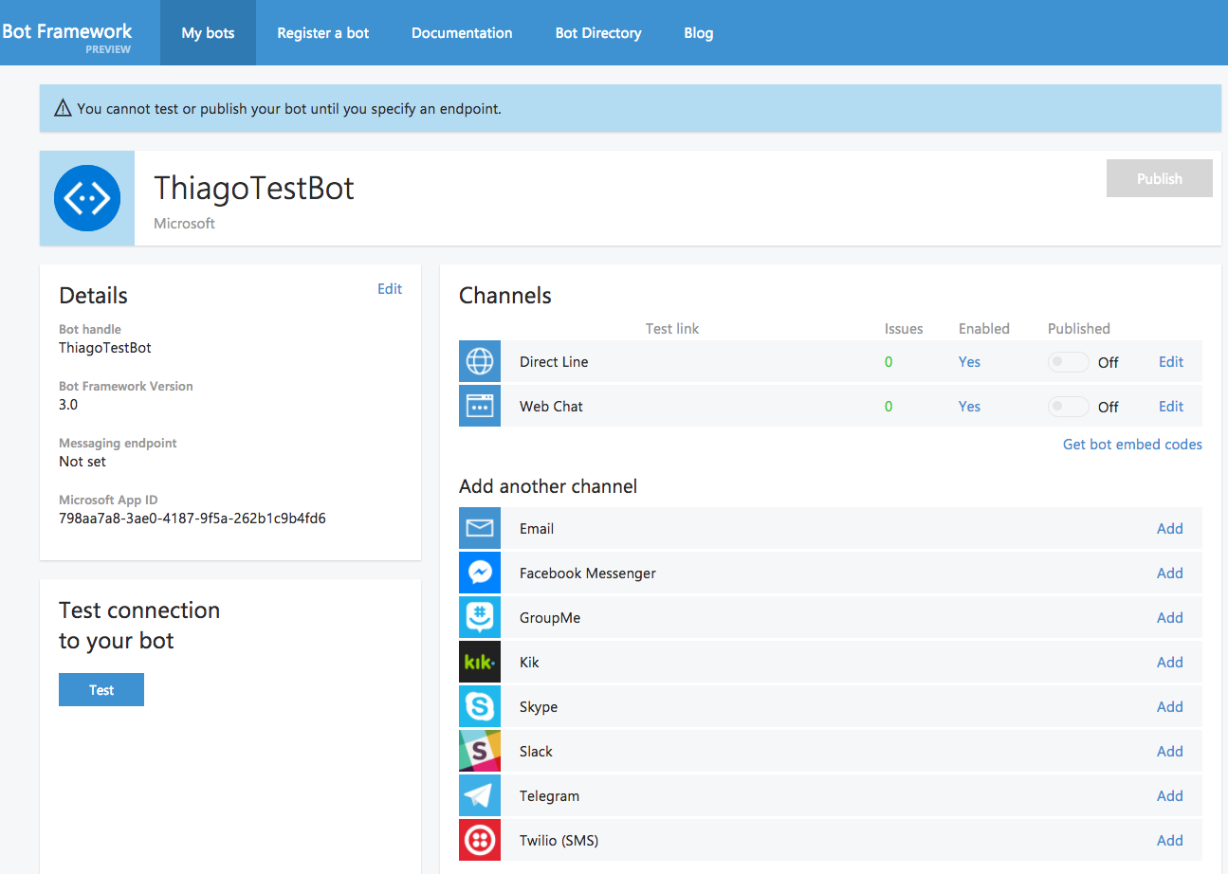
Developer Portal

Slide 37

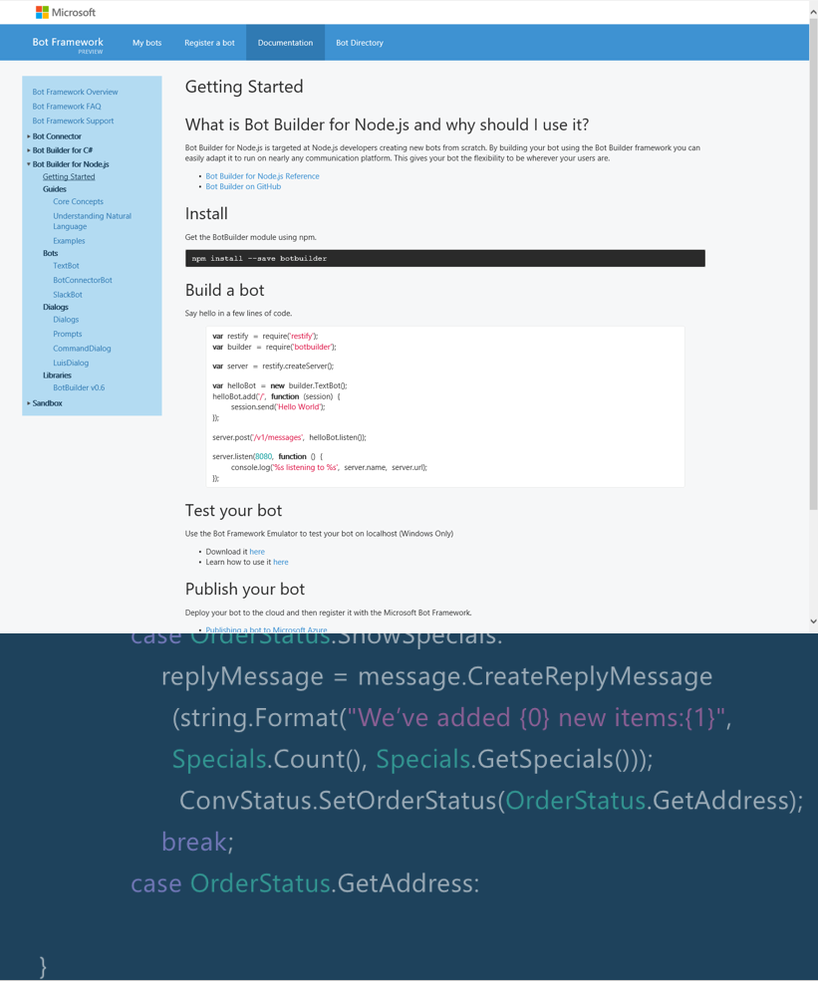
Bot Builder SDKs

Slide 38
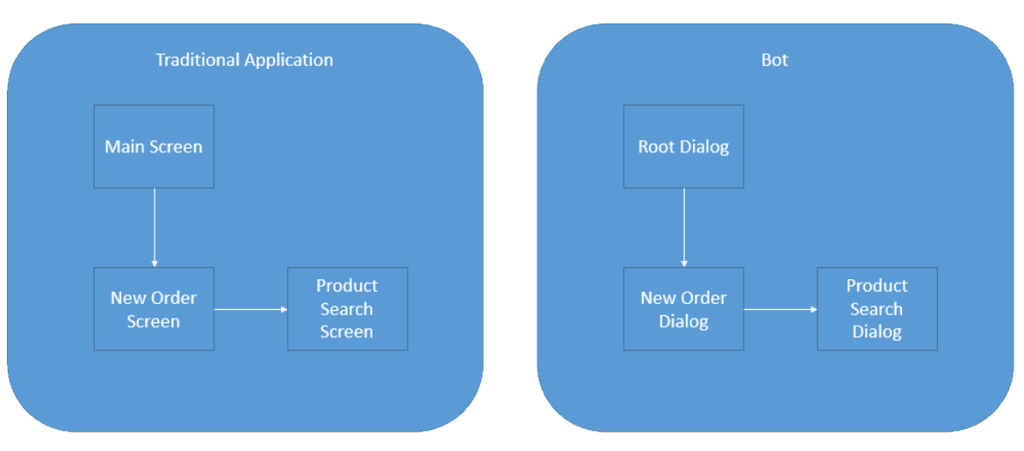
Bot Dialogs

Slide 39
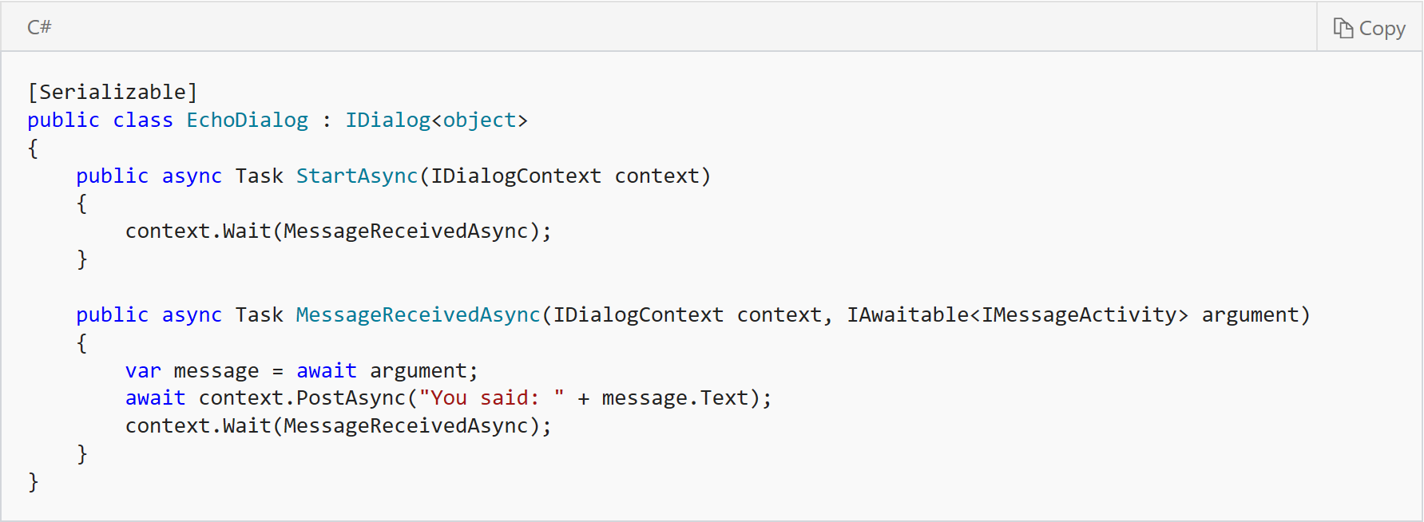
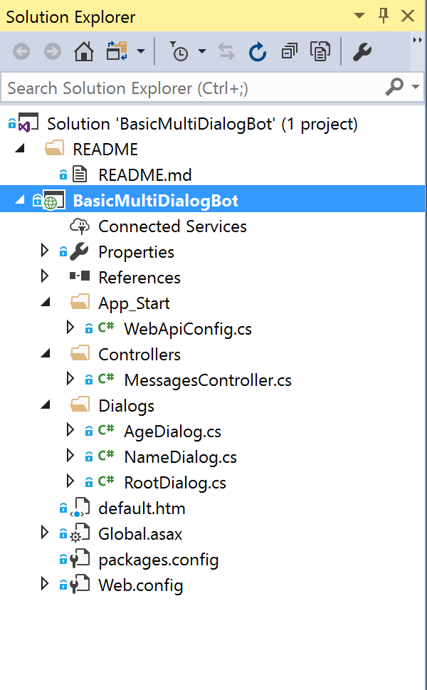
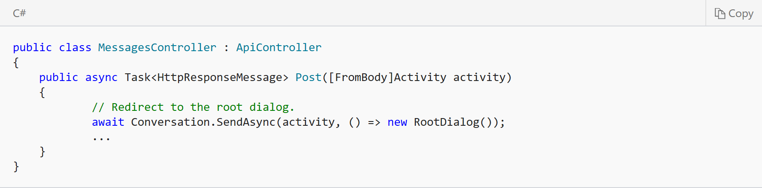
Bot Dialogs

Slide 40
Demo: “Axon Partners” BOT

Slide 41
Cognitive Services

Slide 42









Why Microsoft Cognitive Services?
Easy
Flexible
Tested
Roll your own with REST APIs
Simple to add: just a few lines of code required
Integrate into the language and platform of your choice
Breadth of offerings helps you find the right API for your app
Built by experts in their field from Microsoft Research, Bing, and Azure Machine Learning
Quality documentation, sample code, and community support
GET A KEY
BUILD

Slide 43
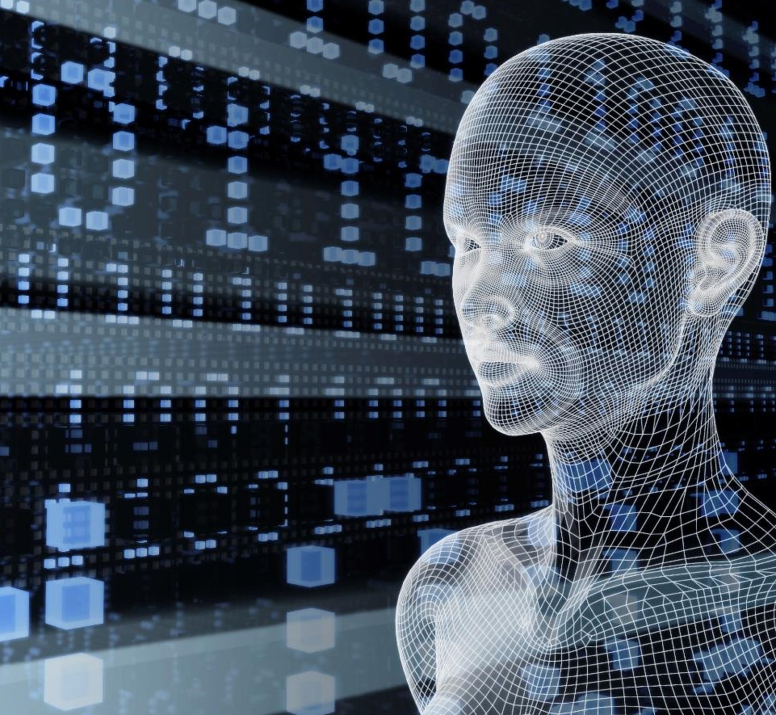
Vision
From faces to feelings, allow your apps to understand images and video
Microsoft Cognitive Services
Give your apps a human side
Speech
Hear and speak to your users by filtering noise, identifying speakers, and understanding intent
Language
Process text and learn how to recognize what users want
Knowledge
Tap into rich knowledge amassed from the web, academia, or your own data
Search
Access billions of web pages, images, videos, and news with the power of Bing APIs

Slide 44
Vision
Computer Vision API
Face API
Emotion API
Video API
Distill actionable information from images
Detect, identify, analyze, organize, and tag faces in photos
Personalize experiences with emotion recognition
Analyze, edit, and process videos within your app

Slide 45
Speech
Bing Speech API
Speaker Recognition API
Custom Recognition Intelligent Service
Convert speech to text and back again, and understand its intent
Give your app the ability to know who's talking
Fine-tune speech recognition for anyone, anywhere

Slide 46




Speech
Language
Bing Spell Check API
Web Language Model API
Linguistic Analysis API
Language Understanding Intelligent Service
Text Analytics API
Detect and correct spelling mistakes within your app
Leverage the power of language models trained on web-scale data
Easily parse complex text with language analysis
Teach your apps to understand commands from your users
Detect sentiment, key phrases, topics, and language from your text

Slide 47

Language
Knowledge
Academic Knowledge API
Knowledge Exploration Service
Entity Linking Service
Recommendations API
Explore relationships among academic papers, journals, and authors
Add interactive search over structured data to your project
Contextually extend knowledge of people, locations, and events
Provide personalized product recommendations for your customers

Slide 48
Search
Knowledge
Bing Web Search API
Bing Autosuggest API
Bing Image Search API
Bing Video Search API
Bing News Search API
Connect powerful search to your apps
Give your app intelligent autosuggest options for searches
Bring advanced image and metadata search to your app
Trending videos, detailed metadata, and rich results
Link your users to robust and timely news searches

Slide 49
Demo: Q&A Maker

Slide 50



Унікальний захід, націлений на вирішення реальних завдань за допомогою технології blockchain
9-11 червня, 2017
Київ, Україна

Slide 51
Q&A

